Slide 1


Digital Forensics Technology and Practices: Project 2 – The Hacker Attacks CST640 Section 9042 Ryan Steggerda 2/1/2024

Slide 2

Project 2 - Introduction
The purpose of Project 2 is to simulate the scenario of an attacker using the dirb tool to discover ssh login credentials and uses the foothold to create an admin account on the users console.
Common hacker activity often includes finding a foothold and using the foothold to create new accounts with higher levels of privilege.
The attacker will often leave a back door into the system for further exploitation at a later date(in this case stealing the ssh host rsa key and user/password).
One of the key artifacts left behind by the attacker is the presence of a new admin account as new files containing the stolen data (Alghanam et al., 2023).

Slide 3
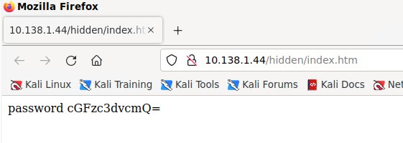
In our Last Episode - Credentials Extracted
The hacker was able to gain access to the system by discovering a hidden directory containing the username and password for an ssh login .
While the password was encoded in Base64 tools such as Cyber Chef can easily crack this code and display the real password (Nadler et al., 2019).
‎January ‎28, ‎2024, ‏‎12:36:48 PM

Slide 4
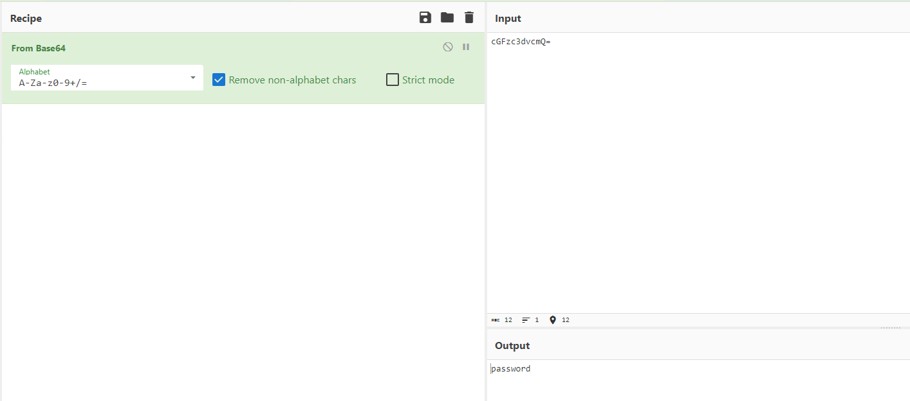
Base64 Decode
‎February ‎1, ‎2024, ‏‎3:58:19 AM

Slide 5
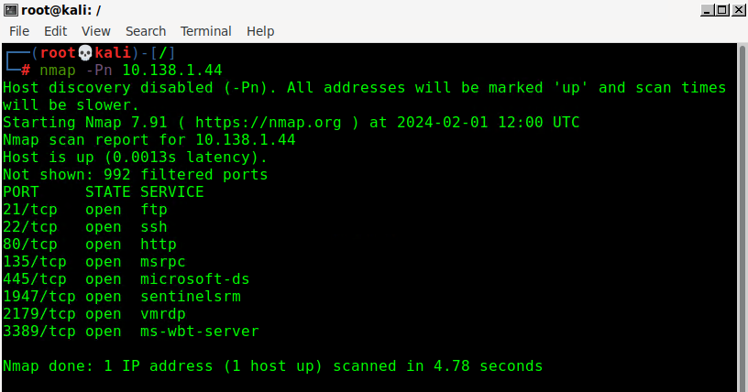
The attacker will Nmap for more information
After using the common port scanning tool, nmap the attacker discovered several vulnerable remote access ports, 22 SSH and 3389 RDP.
Both SSH and RDP are used for remotely accessing users systems and the previously discovered passwords allow for a smooth login attempt over port 22 (Chung et al., 2023).
‎February ‎1, ‎2024, ‏‎4:01:23 AM​

Slide 6
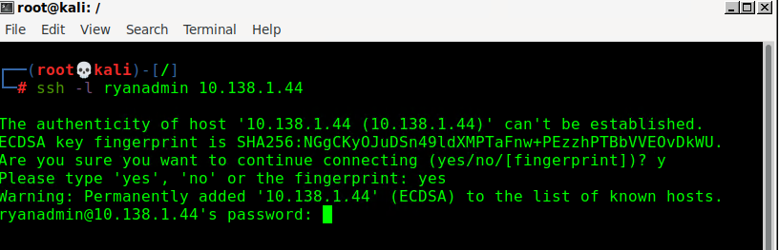
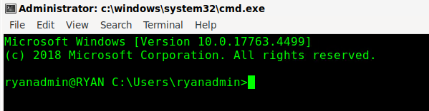
SSH into the Windows Victim
As seen below, the attacker needs the users IP address, and username/password to take advantage of the open ssh port.
After entering the credentials the attacker now has complete access to the admin account on the user "Ryan's" system.
‎February ‎1, ‎2024, ‏‎4:05:22 AM
‎February ‎1, ‎2024, ‏‎4:06:07 AM

Slide 7
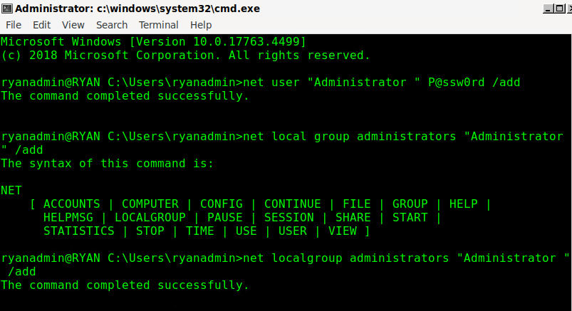
Add an Administrative Account
Attackers will almost always attempt to create new accounts after gaining access to the users system.
Visualized below is the common way attackers will create new admin level accounts on a victims system.
New accounts allow the attacker to gain a permanent foothold on the users system and help prevent the user from discovering their presence.
‎February ‎1, ‎2024, ‏‎4:12:52 AM

Slide 8
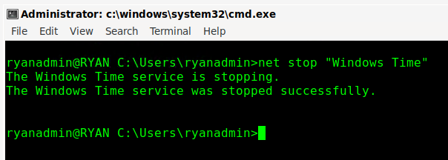
Stop A Service
One of the first actions an attacker will make is attempting to disable troublesome programs, such as services related to the firewall and Windows Defender.
Using this opportunity to weaken the users defenses makes future attacks more successful and may allow the attacker to install malware and possible backdoors which the firewall and defensive services would pick up (Willems et al., 2023).
‎February ‎1, ‎2024, ‏‎4:15:59 AM

Slide 9
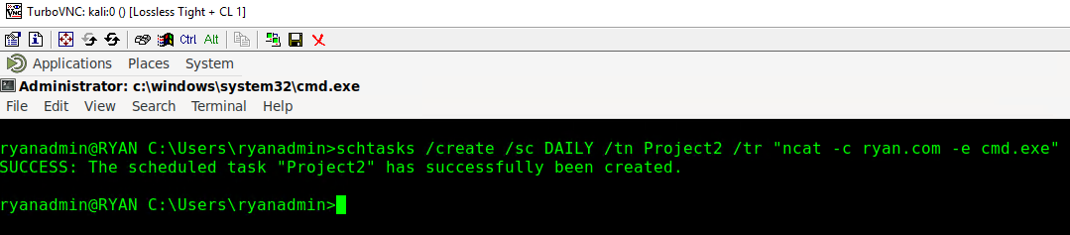
Creating a Scheduled Task (Backdoor)
Scheduling tasks is one of the best weapons an attacker has for prolonged attacks on the system.
The longer an attacker is logged onto the users system the better chance of being caught.
Attackers can schedule tasks to send data to the attackers system or upload malware without even being logged into the users account.
Scheduled tasks are also difficult to catch for average users as they often occur in the background.
‎February ‎1, ‎2024, ‏‎4:19:18 AM​

Slide 10
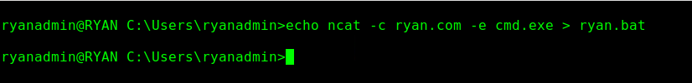
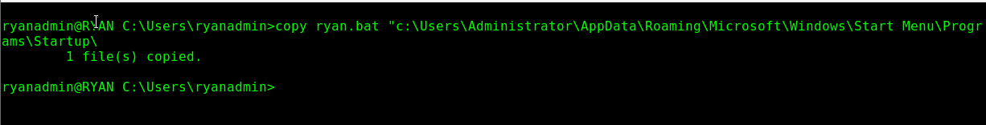
Adding a Batch File to Startup
Batch files, as seen below, are simply script files that are designed to run repetitive tasks from the windows cmd.
Attackers can force the users system to run self made batch files during the startup phase to perform a number of tasks, such as sending a signal to the attackers system and downloading malware (Zhan et al., 2022).
The startup directory is often target choice for these malicious batch files as often times the startup is the best time to run these scripts to avoid detection.
‎February ‎1, ‎2024, ‏‎4:20:38 AM
‎February ‎1, ‎2024, ‏‎4:22:19 AM​

Slide 11
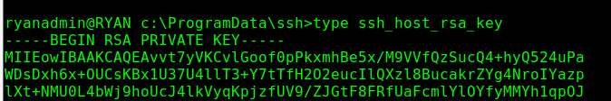
Stealing Data
SSH private keys are highly confidential blocks of characters used for a variety of purposes including decoding data, automation, and automated sign on.
The automated sign on, or in Windows case, Single Sign On(SSO) is what the attacker was after as it can be used to verify the attackers identity as the victim.
It is recommended that companies routinely replace the employees private keys to prevent scenarios such as this one from occurring.
‎February ‎1, ‎2024, ‏‎4:27:59 AM
‎February ‎1, ‎2024, ‏‎4:28:36 AM

Slide 12
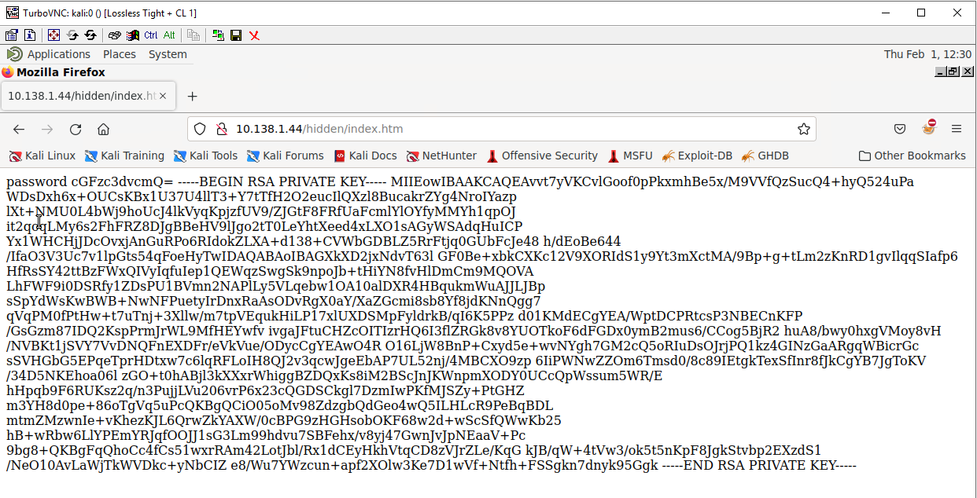
Data Exfiltration
The image provided shows a common method for data exfiltration.
Data exfiltration is the process of an attacker moving the data from the target system to an external location.
There are many ways this can occur from directly sending the data from the victims system to the attacker, or in this case posting the desired data to a domain only known to the attacker (What Is Data Exfiltration? (Definition & Prevention), n.d.).
Posting the info to a searchable domain can help hide the attackers identity by creating a "drop zone" of sorts.
‎February ‎1, ‎2024, ‏‎4:31:07 AM

Slide 13
Summary
Project 2 introduced students to many new tools, such as nmap, ssh keys, and Cyber Chef.
The goal was to simulate an attack on a user with the intent of stealing the users private ssh key to create a reliable backdoor into the system for future use.
Students also recreated some of the common actions taken by the attacker once in, such as creating new users, disabling startup programs, creating new startup services, and exfiltrating private keys.
Recreating the steps personally helped cement how methodical many attacks are, which makes them detectable in a certain sense once the core patterns are understood and discovered.

Slide 14
References
Alghanam, O. A., Alazzam, H., Elshqeirat, B., Qatawneh, M., & Almaiah, M. A. (2023). Real-Time Detection System for Data Exfiltration over DNS Tunneling Using Machine Learning. Electronics, 12(6), 1467. https://doi.org/10.3390/electronics12061467
Chung, M., Yang, Y., Wang, L., Cento, G., Jerath, K., Taank, P., Raman, A., Chan, J. H., & Chignell, M. (2023). Enhancing cybersecurity situation awareness through visualization: A USB data exfiltration case study. Heliyon, 9(1), e13025. https://doi.org/10.1016/j.heliyon.2023.e13025
Nadler, A., Aminov, A., & Shabtai, A. (2019). Detection of malicious and low throughput data exfiltration over the DNS protocol. Computers & Security, 80, 36–53. https://doi.org/10.1016/j.cose.2018.09.006
What is Data Exfiltration? (Definition & Prevention). (n.d.). Digital Guardian. https://www.digitalguardian.com/blog/what-data-exfiltration
Willems, D., Kohls, K., Van Der Kamp, B., & Vranken, H. (2023). Data Exfiltration Detection on Network Metadata with Autoencoders. Electronics, 12(12), 2584. https://doi.org/10.3390/electronics12122584
Zhan, M., Li, Y., Yu, G., Li, B., & Wang, W. (2022). Detecting DNS over HTTPS based data exfiltration. Computer Networks, 209, 108919. https://doi.org/10.1016/j.comnet.2022.108919

